Slide 1



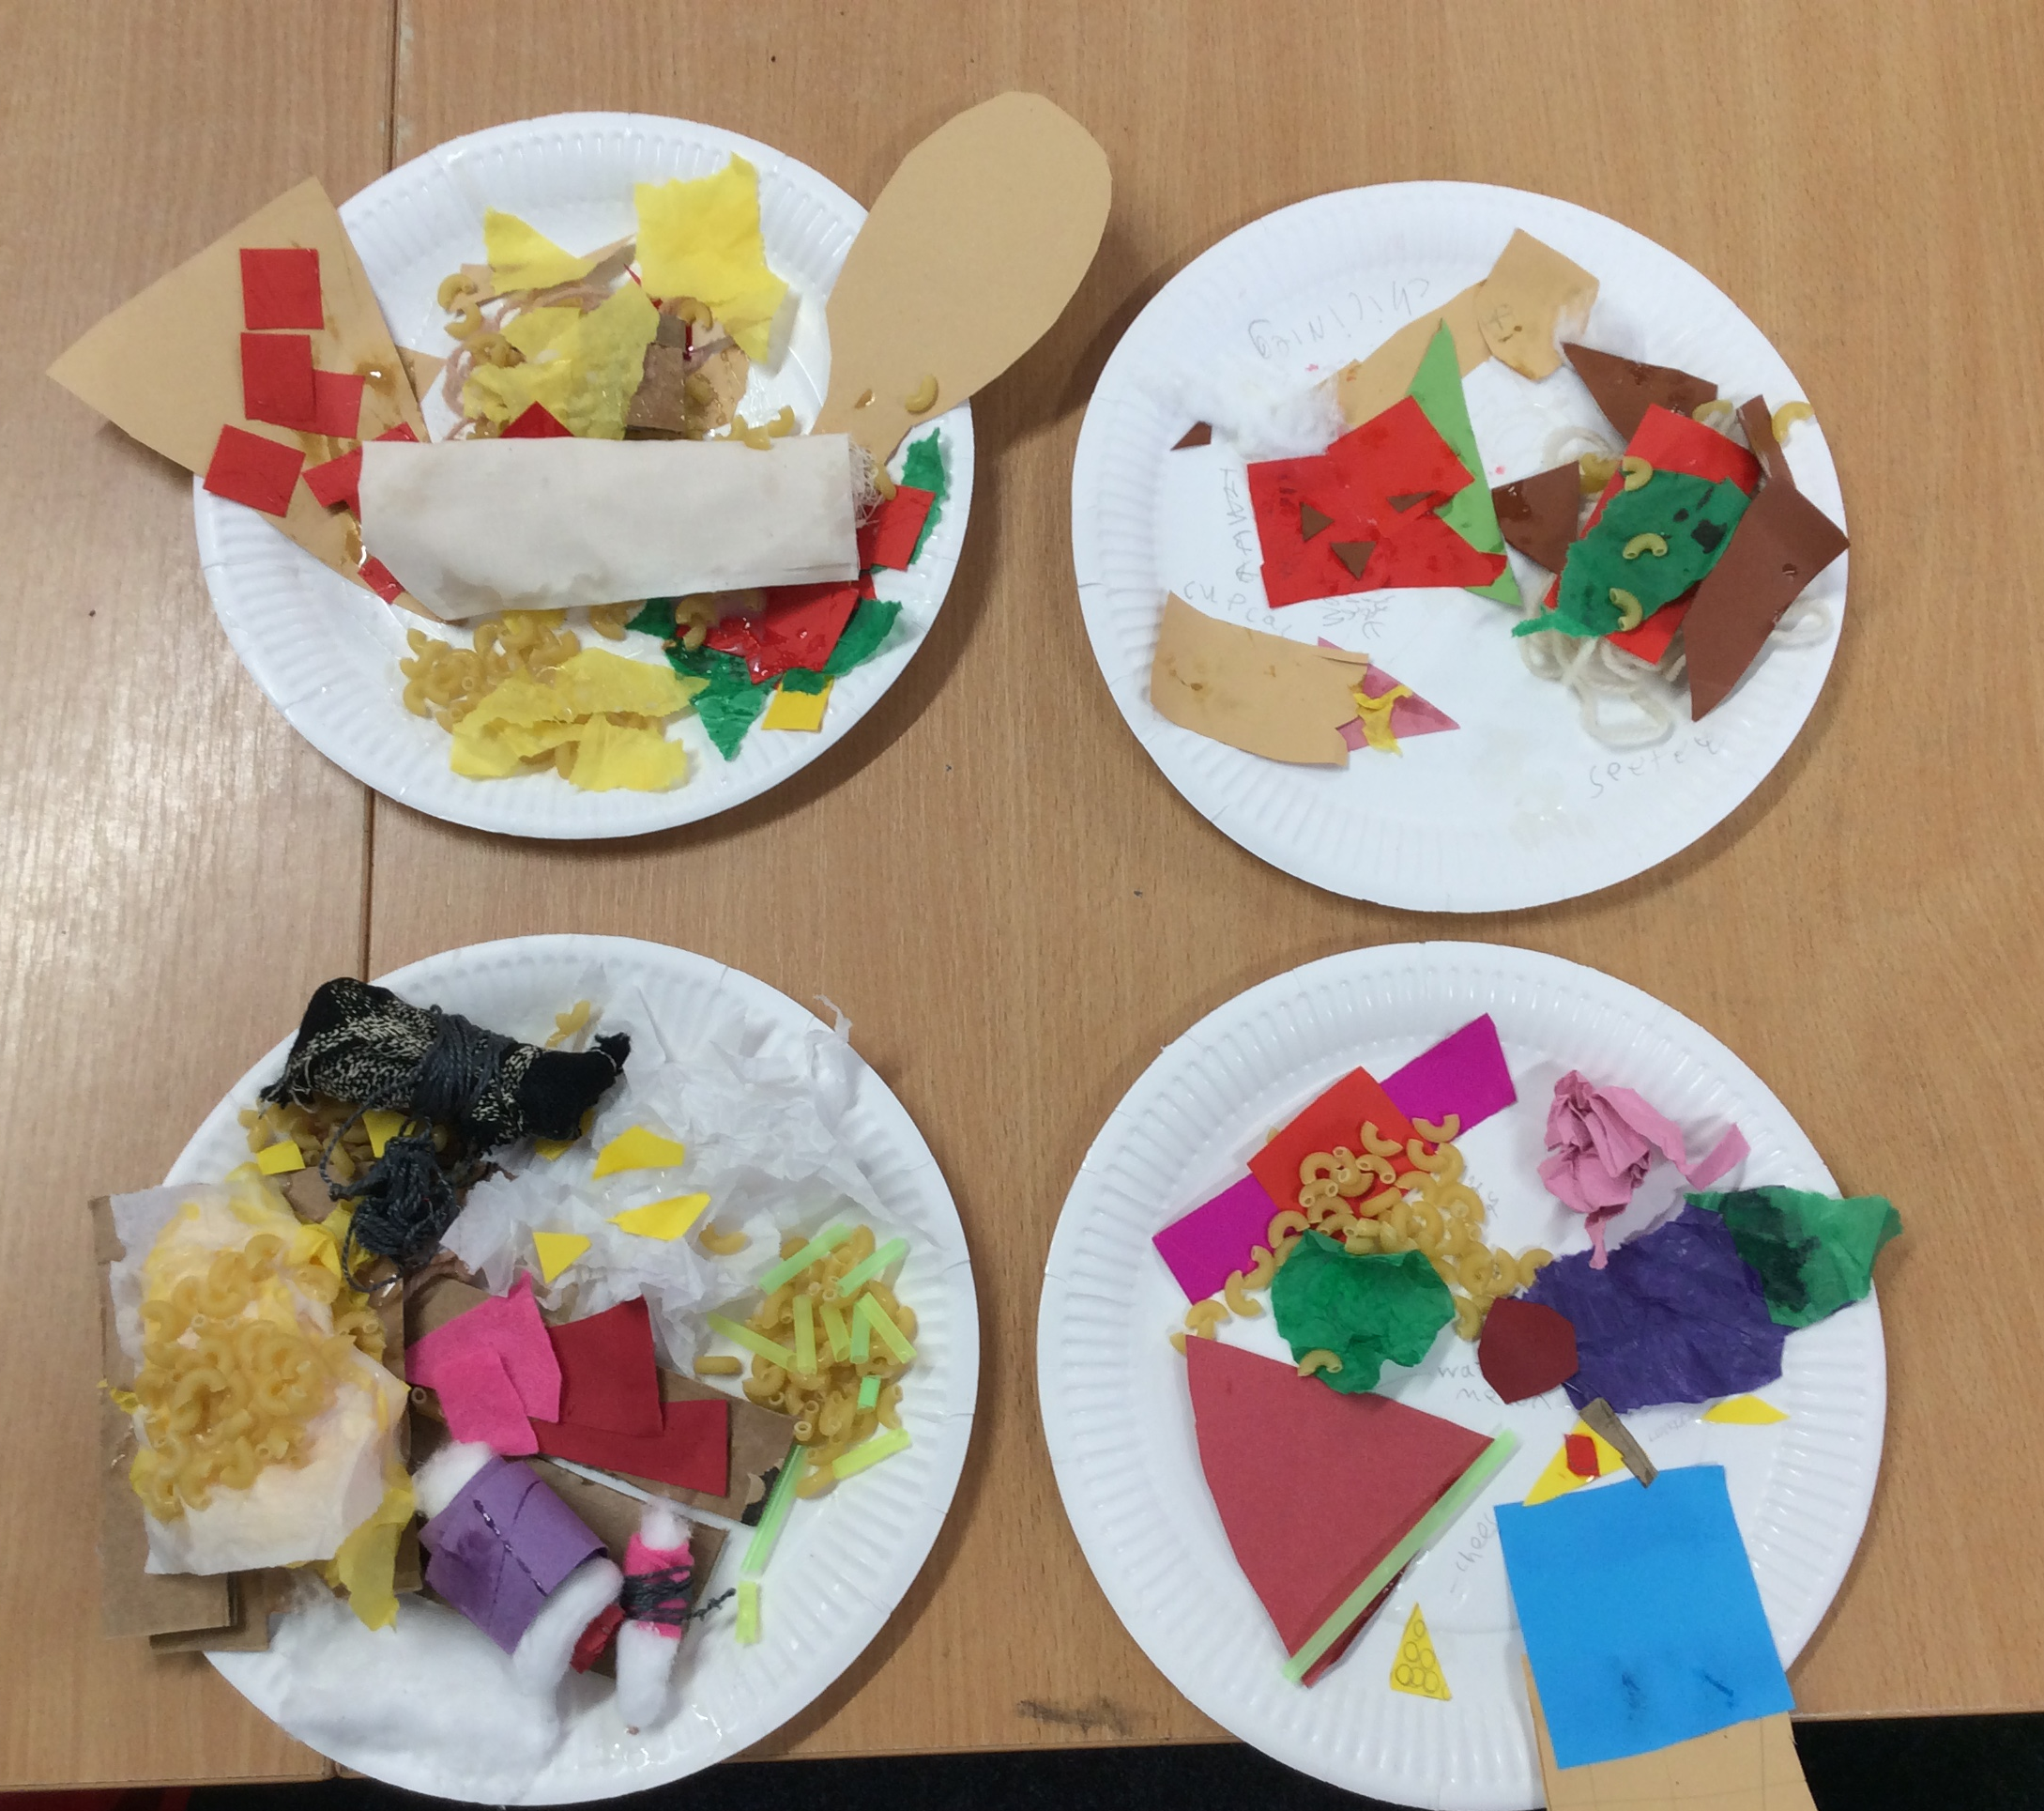
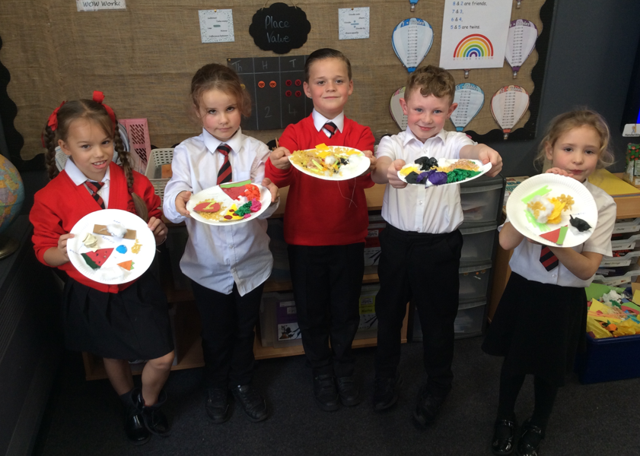
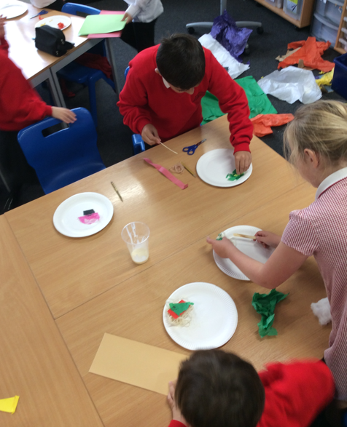

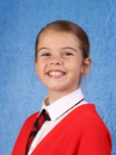
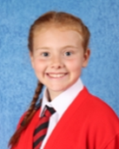

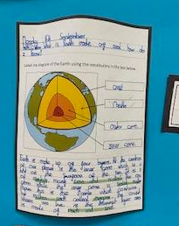
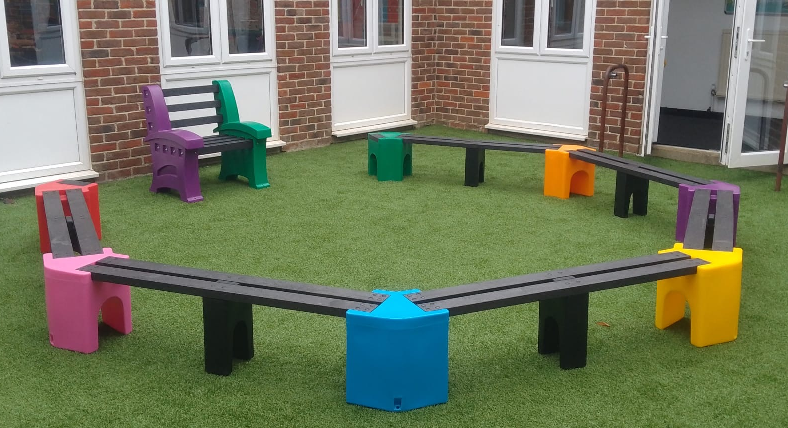


Friday 4th October 2024
Head of School Message
Thank you to all those families who have donated for our harvest festival celebration. We will be holding our special celebration assembly on Monday for the children. Your donations will then be given to The Edenbridge Foodbank.
A big congratulations to our newly elected Head Pupils, Prefects and Sports Leaders! I know that you are going to do a wonderful job in your new roles and take your responsibilities very seriously. We are hurtling towards the end of the half term. The next two weeks are going to be busy, with workshops, sporting tournaments, class assemblies and to finish it off, one spectacular monster ball!
Parents Evening
Parents Evening will be on Wednesday 6th November and Thursday 7th November. Information on how to book appointments has been emailed to you. We are looking forward to sharing your child’s successes and progress.
Head Pupils
We are thrilled to announce the results of our Head Pupil elections! After an exciting campaign, our students have cast their votes, and we have two outstanding winners. Congratulations to Tali and Connie, who have been chosen by their peers to represent the school as Head Pupils for this academic year. Both candidates demonstrate strong leadership, kindness, and a commitment to making our school community even better. Well done to all who participated, and thank you to everyone who voted!
Around the school in pictures!
A HUGE thank you to our PTFA
for providing us with new outdoor
seating for our courtyard!
Attendance
This weeks attendance figures.
Whole school attendance:
94%
Class | % | Class | %
Tower | 96 | Golden Gate | 93
Westminster | 97 | Lions Gate | 97
Severn | 91 | Manhattan | 93
Clifton | 95 | Ikuchi | 91
Jubilee | 95 | Anji | 90
Tyne | 94 | Auckland | 96
Amb | 93 | Seacliff | 95
Black History Month
Upcoming Dates
Thurs 10th Oct –
Wear yellow for World Mental Health Day &
flu immunisations
Weds 16th Oct – Yr 3 Science Workshop
Fri 18th Oct – Monster Ball
Sat 2nd Nov – Edenbridge Bonfire Parade
This week is the start of Black History Month. The theme this year is Reclaiming Narratives. Over the course of the next month, each year group will be completing various activities linked to this theme. We will then be creating a book, as a school, to showcase the learning.

